Slide 1
UML Diagram Assistance System
Panther
למא אבו אלאנעאג'
מוחמד עיסאוי
ליאן אבו סיני
לנא יעקוב

Slide 2
System Updates & Improvements
Model Upgrade: Replaced Gemini API with ChatGPT for better performance.
Expanded Diagram Types: Now supports generating Class, Sequence, Activity, and Use Case diagrams.
Prompt Engineering: Tested different prompts to identify the most effective approach.
Evaluation: Assessed the system using various texts across different languages and lengths.

Slide 3
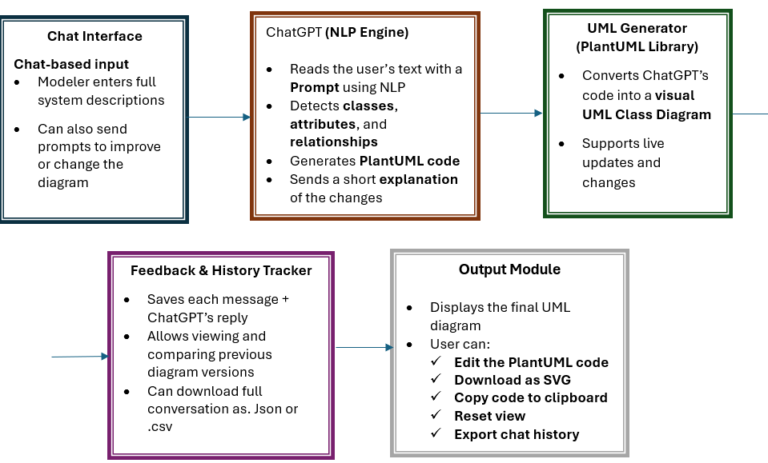
Solution Design

Slide 4
prompt
You are a senior software engineer and UML architect.
Your task is to read the following system description and generate a valid **${diagramType}** diagram using **PlantUML** syntax.
--- SYSTEM DESCRIPTION ---
"${description}“
--------------------------
INSTRUCTIONS:
Generate only the PlantUML code, no explanations or markdown (no triple backticks).
Start with @startuml and end with @enduml.
Use PlantUML syntax conventions appropriate for the selected diagram type (${diagramType}).
Make logical assumptions where the story lacks technical detail.
Be consistent with naming and structure.
Use best practices for clean and readable UML diagrams.

Slide 5
EXAMPLES of supported diagram types:
Class Diagram: class definitions, inheritance, associations
Sequence Diagram: participants, messages, activation bars
Use Case Diagram: actors, use cases, relationships
Activity Diagram: actions, decisions, flows
Component Diagram: components, interfaces, dependencies
REFERENCE:You can use the following format if helpful:
${JSON.stringify(diagramTemplates)}
Output only valid PlantUML code for a ${diagramType}.
`;

Slide 6
Prompt for Improve
const prompt = `
You are a senior software engineer and UML assistant.
You will be given a PlantUML-based **${diagramType}** diagram along with:
- The original system description
- The current UML diagram
- A user request (modification or question)
TASK:
- If the user is asking a question, answer it clearly based on the diagram and story.
- If the user is asking for a change, apply it to the diagram using correct PlantUML syntax for a ${diagramType}.
- Always include a brief explanation first.
- If the UML was updated, return the updated diagram **inside a \`\`\`plantuml\`\`\` code block only**.

Slide 7
ORIGINAL SYSTEM DESCRIPTION:
"${originalStory}"
CURRENT UML CODE:
@startuml
${currentUML}
@enduml
USER REQUEST:
"${userMessage}"
Your response must contain:
1. A clear explanation of the change or answer.
2. The updated UML diagram in a \`\`\`plantuml\`\`\` code block if modified.
`;

Slide 8
evaluation
we used 9 diverse system descriptions taken from real exercises and exams. The systems were selected to cover different types of systems and logical structures:
Movie Shop – A system for ordering and renting movies
Flights – A system for managing flights, airplanes, and pilots
Bank System – A customer accounts system, including investments
Company & Departments – An organizational system with offices and employees
AreaDog – An operational system for military dogs, including sensor data
W2Rent – A system for managing car rentals
FlipCoin - system for managing secure product transactions and mining operations
Online Library System
Smart Parking System
For each system, we had:
A full textual description
An original UML diagram
A diagram generated by our system after five improvement prompt
Notes:
לצורך הערכת הפתרון, השתמשנו ב־6 תיאורי מערכות מגוונים

Slide 9
Results and Conclusions

Slide 10
Class diagram
Criterion | Movie Shop | Flights | Bank System | Company & Departments | AreaDog | W2Rent | FlipCoin | Online Library | Smart Parking
System Requirements Coverage | 80% | 82% | 88% | 76% | 74% | 72% | 85% | 80% | 78%
Accuracy in Defining Entities | 84% | 80% | 90% | 78% | 76% | 74% | 87% | 82% | 80%
Accuracy in Defining Attributes | 78% | 76% | 86% | 74% | 72% | 70% | 83% | 80% | 78%
Relationships Between Components | 72% | 74% | 86% | 80% | 75% | 70% | 82% | 78% | 77%
AVG score | 79% | 78% | 88% | 77% | 74% | 72% | 84% | 80% | 78%

Slide 11
Sequence Diagram
Criterion | Movie Shop | Flights | Bank System | Company & Departments | AreaDog | W2Rent | FlipCoin | Online Library | Smart Parking
System Requirements Coverage | 78% | 80% | 85% | 75% | 72% | 70% | 84% | 78% | 76%
Accuracy in Defining Entities | 82% | 79% | 88% | 77% | 74% | 72% | 85% | 80% | 78%
Accuracy in Defining Messages | 74% | 72% | 84% | 72% | 70% | 68% | 80% | 76% | 74%
Correct identification of the order of messages | 76% | 78% | 86% | 80% | 73% | 70% | 82% | 78% | 77%
AVG score | 78% | 77% | 86% | 76% | 72% | 70% | 83% | 78% | 76%

Slide 12
Use Case Diagram
Criterion | Movie Shop | Flights | Bank System | Company & Departments | AreaDog | W2Rent | FlipCoin | Online Library | Smart Parking
System Requirements Coverage | 85% | 86% | 90% | 80% | 77% | 76% | 88% | 84% | 82%
Accuracy in Defining actors | 86% | 84% | 91% | 82% | 78% | 76% | 89% | 85% | 83%
Accuracy in Defining use cases | 78% | 76% | 85% | 74% | 72% | 70% | 84% | 80% | 78%
Relationships Between Components | 80% | 82% | 88% | 84% | 78% | 74% | 86% | 82% | 80%
AVG score | 82% | 82% | 89% | 80% | 76% | 74% | 87% | 83% | 81%

Slide 13
Conclusions
The system successfully generates diagrams with good basic coverage, especially for simpler systems.
It identifies main entities, basic relationships, and simple structures well.
For more complex systems (e.g. W2Rent, AreaDog), it detects key entities but struggles to capture all required details for complete and precise diagrams.
Models are partially accurate: sometimes missing attributes or relationships, though when relationships are generated, they are usually correct.
The main weakness is handling complex compositions and hierarchies.
Overall, it gives a good starting point, but human review is needed for full accuracy...
Notes:
המערכת שלנו מצליחה להפיק תרשימי Class ברמה בסיסית טובה, במיוחד עבור מערכות פשוטות – היא מזהה ישויות עיקריות, קשרים בסיסיים ומבנים היררכיים פשוטים. עם זאת, כשמדובר במערכות מורכבות יותר כמו W2Rent ו-AreaDog, היא מתקשה להציג תרשים מלא ומדויק – לעיתים חסרים שדות, קשרים או קומפוזיציות. הבנו שאי אפשר להסתמך לחלוטין על התוצאה האוטומטית, וחשוב מאוד לבדוק כל תרשים מול הדרישות המקוריות. בנוסף, נחשפנו לחשיבות של שמירת גרסאות ותיעוד ההיסטוריה, כדי לאפשר שיפור הדרגתי ולמידה מהתהליך. בסופו של דבר, המערכת מספקת התחלה טובה – אבל היא כלי עזר, לא תחליף למהנדס תוכנה.

Slide 14
Thank you

